Slide 1

CMN 1160A – Introduction to Media Studies
Week 9A: Communications Policy: What is communication for?
Daniel J. Paré
University of Ottawa, Department of Communication
November 1, 2016

Slide 2
Preview
Defining Communication Policy
Canadian Policy Context

Slide 3
What is Communication Policy?
Public Policy:
“a course of action or inaction chosen by public authorities to address a given problem or interrelated set of problems” (Pal, 2001: 2)
Communication Policy:
a course of action or inaction chosen by public and private authorities to address a given concern or interrelated set of concerns associated with the diffusion of information and knowledge

Slide 4
What is Communication Policy?
Communication
Policy
Telecoms
The Press
Broadcasting
Information
Technology

Slide 5
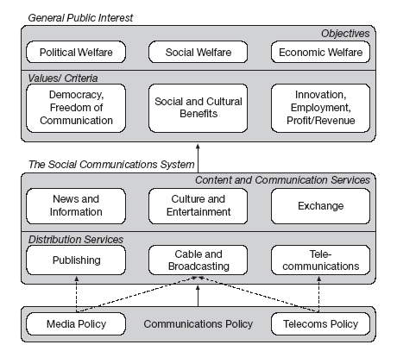
Elements of media and communication policy
Source: van Cuilenburg, J., and D. McQuail (2003). Media policy paradigm shifts: Towards a new communications policy paradigm. European Journal of Communication 18 (2):184

Slide 6
‘Public Interest’ Goals
Political Welfare
Economic Welfare
Social Welfare

Slide 7
Communication Framework in Canada
Legislation
(Parliament, Government)
Constitution
Broadcasting Act
Telecommunications Act
Orientation
(Cabinet, Minister of Canadian Heritage, Minister of Industry)
Administrative measures
Policy guidelines
Nomination of officers
Appeal of regulatory decisions
Power to direct the regulator
Regulation
(Canadian Radio-Television and Telecommunication Commission)
Policy development
Licensing
Supervision of industry self- regulation

Slide 8

Marketplace of Ideas
“Widest possible dissemination of information from diverse and antagonistic sources is essential to ensuring the ‘public interest’”

Slide 9
Marketplace of Ideas
Economic Theory
media/communication policy issues = problems of maximizing efficiency
Improved economic efficiency = improved social welfare
Need to minimize government interference in the market
Social Value Theory
‘free markets’ only one means of improving social welfare
‘free markets’ may have socially undesirable effects
Some level of government intervention may be beneficial

Slide 10
Justifications for Regulation
Market Failure:
Situation where societal policy objectives (social, economic, political) cannot be met by an ‘uncontrolled’ market
Communications regulatory issues include:
Preventing anti-competitive behavior
Protecting consumers (i.e. privacy)
Universal Service
Content
Culture

Slide 11
Levels of Regulation
1. Internet specific issues
Domain names
Route server structures
Code (i.e. hardware and software constituting ‘cyberspace’)
2. ICT sector issues
Many industry specific governance mechanisms for telecoms, broadcasting, and computing becoming obsolete
Technological convergence
3. Broader issues of widespread Internet use
Privacy
Consumer protection
Intellectual property rights
Contract enforcement
Spam, Viruses, Worms, etc

Slide 12
Recall: Structure of the Internet
Key Feature = Internet consists of ‘4 layers’
1. Content/Transaction Layer
Info available on or over the Internet, including Web sites (i.e. email, music files, video streams, & transactions).
2. Application Layer
Hardware & software (i.e. email, Web browsers, html)
3. Logical Infrastructure Layer
‘Glue’ that ties all 4 layers together (i.e. communication protocols – TCP/IP; domain names etc)
4. Physical Infrastructure Layer
telephone & cable TV access lines, network lines
Notes:
‹#›

Slide 13
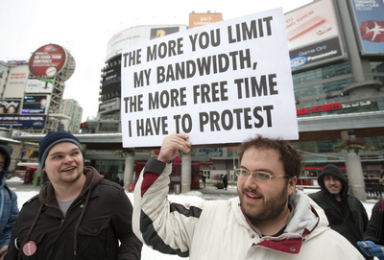
Public Policy and Digital Technologies
What is the appropriate balance between competition & regulation?
How can copyright be protected?
How can Canadian culture be protected?
How can privacy be protected?

Slide 14

Protecting Intellectual Property
Copyright
Exclusive right to use, display, distribute or copy a creative work or to allow someone else to do so
to qualify, a work must be original, and fixed in an identifiable and more or less permanent material form sign of technology
Does not cover ideas, only their expression

Slide 15
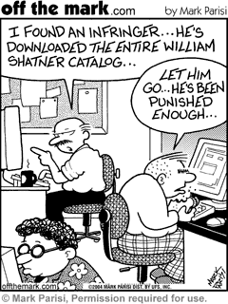
Protecting Intellectual Property
Copyright infringement
Unauthorized use (publication, performance, etc) or duplication of copyrighted material without permission or license
Exceptions/Limitations
Fair dealing / Fair use
Compulsory licence
Categories of users
Time limits

Slide 16

Privacy Legislation
Privacy Act (1983) – federal public sector
Personal Information Protection and Electronic Documents Act (2001) - “PIPEDA”
Privacy Commissioner

Slide 17
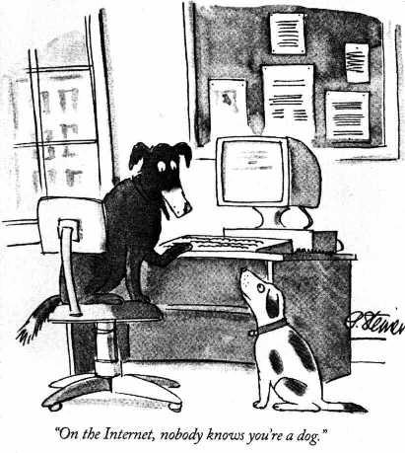
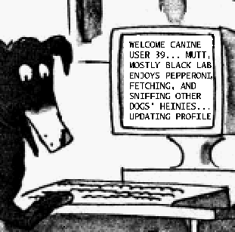
Source:
Reproduced from page 61 of July 5, 1993 issue of The New Yorker, (Vol.69 (LXIX) no. 20)

Slide 18

CRTC Hearings on Net Neutrality, October 31 – November 4, 2016

